Slide 1
Keeping the Sabbath Day Holy is a Commandment

Slide 2
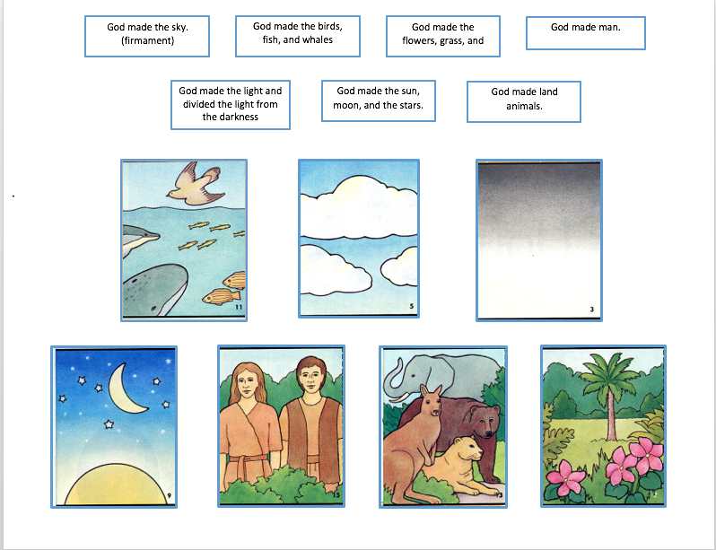
What day of the week is missing on the Creation Game chart?

Slide 3
The 7th
What happened on the 7th day in
the Creation account?
See Genesis 2:1-3

Slide 4
God sanctified the day and rested from his labors.

Slide 5
Since the beginning of the world, one day a week has been set apart as a sanctified day. We call this day the Sabbath.
Sanctified Definition:
Set apart as or declared holy.
Make legitimate or binding by religious sanction.
Free from sin; purify

Slide 6
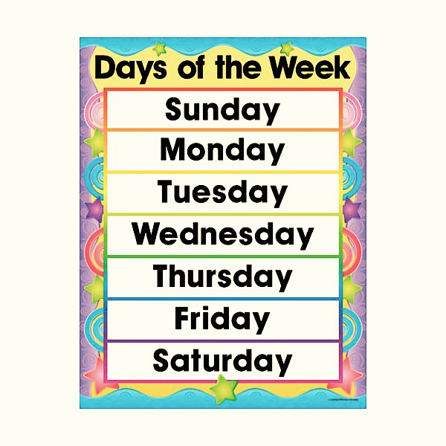
Which day of the week do we observe the Sabbath on?
Image from clipart library

Slide 7
Sunday
Image: Friend September 2016

Slide 8
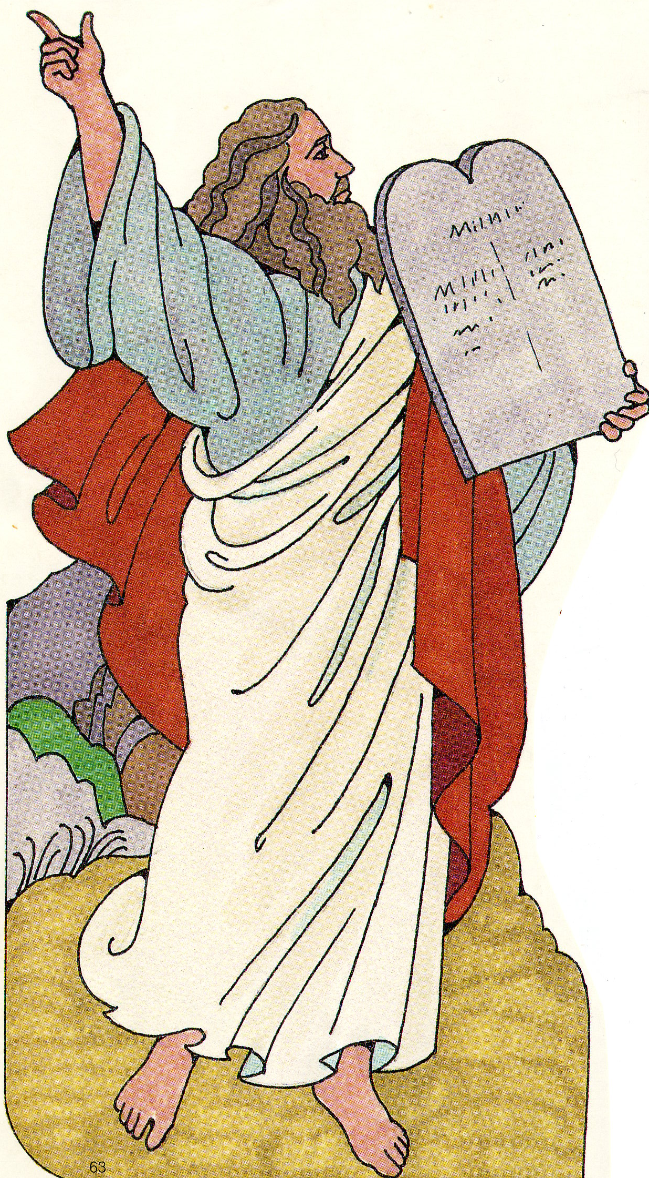
When Moses was on the earth, the Lord gave him some stone tablets.
What was written on those tablets?

Slide 9
The Ten Commandments
One of those commandments is found in Exodus 20:8. Look up and read this scripture.
Image from Susan Fitch Illustration and Design.

Slide 10
Remember the Sabbath Day to keep it holy. Exodus 20:8
Keeping the
Sabbath Day holy is a Commandment.

